Slide 1
DAY 1 – Python Kickoff

Slide 2
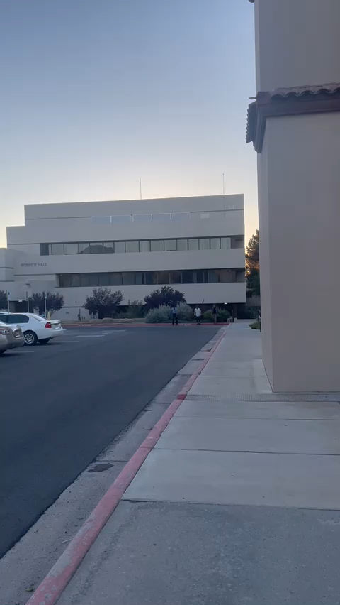
ABOUT ME (Not self centered in the slightest)
4th year PhD student at New Mexico State in exoplanet demographics
I get up to all sorts of nonsense, like running a sprint in dress clothes.
Exhibit A:

Slide 3
CODE OF CONDUCT
I noticed they sent a 2 page of code of conduct
I could not give a fuck. What is this? A tea room in Victorian Era Edinburgh?
Just don’t be a miserable wanker, and we’ll get along just fine
Actual poster that hangs on my wall:

Slide 4
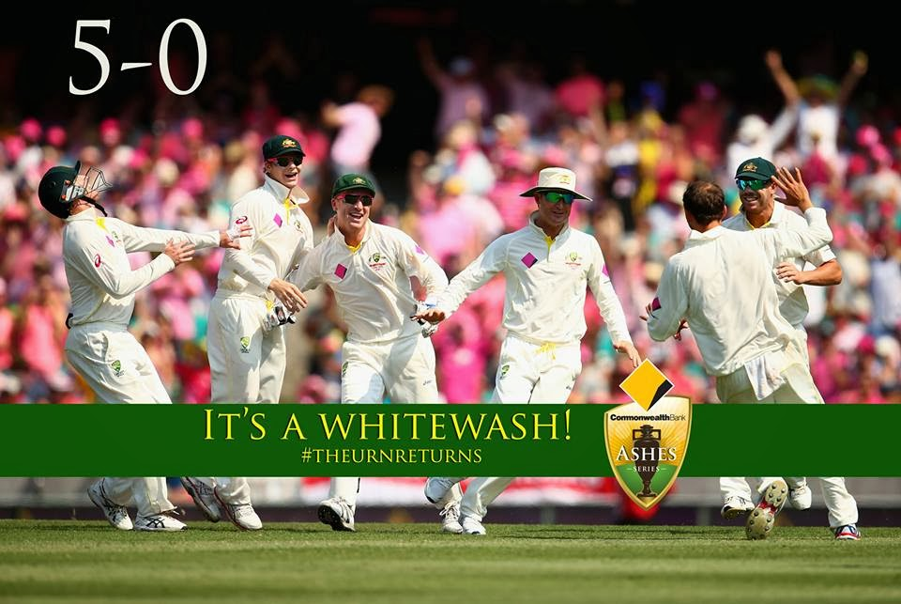
F*CK OFF

Slide 5
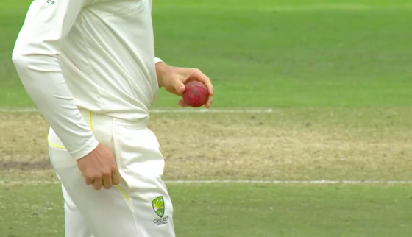
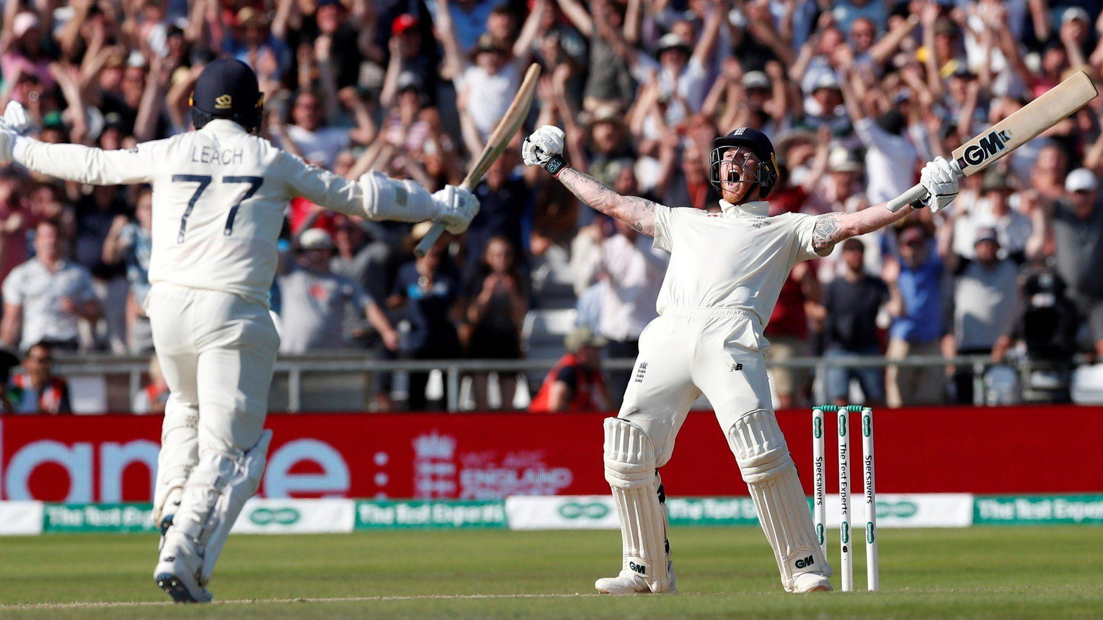
ACTUAL RULES
As long as that poster hangs on the wall, I’m legally required to hate the Brits. So no reason to call me Sir, just Asif!
Don’t talk to me about sandpaper — I’m not mad they rubbed it, just mad they got caught. Everybody shines the ball, we just leaned a bit too far into good old fashioned Australian ingenuity.
No chat about Headingley 2019 either, nothing happened there. We just retained the Ashes 2-1 at Old Trafford

Slide 6
WHAT THE WORKSHOP IS (AND Isn't)
IS
A place to learn the basics hands-on – you write the code
A chance to ask “stupid” questions – except, of course, about Headingley 2019.
ISN’T
A place to sit silently when you have no bloody clue what’s happening.
A formal lecture – we’ll talk, stuff up and learn together.

Slide 7
THE GAME PLAN
S1: Python Basics – Variables, conditionals, loops, functions
S2: Plotting – Reading data files and plotting data
S3-S4: Finding transiting exoplanets
S5-S6: Measuring transiting parameters
S7 (Stretch Goal): Real TESS Light Curves
S8: Wrap-up
None of this is set in stone. We can add or take away things as we go

Slide 8
WHAT YOU NEED
Browser open for Colab / Locally installed Python IDE
That’s about it

